Slide 1

Online Food Ordering System
Abhishek Kumar
2047001
BSC CS

Slide 2
Let’s Begin

Slide 3
Introduction
A web-based platform that allows customers to order food from restaurants and other food providers through a website. This system simplifies the process of ordering food by providing customers with a user-friendly interface to browse menus, select items, and pay for their order online.

Slide 4
Introduction
Online Food Ordering Systems have become increasingly popular in recent years due to their convenience, speed, and accessibility, making them a preferred choice for customers and food businesses alike.

Slide 5
System Requirements

Slide 6
Simple Process
Navigate
Select
Order
Navigate the restaurant’s menu.
Select an item from the menu.
Place an order

Slide 7
System Requirements
Hardware Requirement
• 256 MB Ram
• 512 KB Cache Memory
• Hard disk 10 GB
• Pentium-IV(Processor).
Software Requirement
Operating System: Windows
Web-Technology: PHP
Front-End: HTML,CSS,JAVASCRIPT
Back-End: MySQL
Web Server: Apache SERVER, e specification

Slide 8
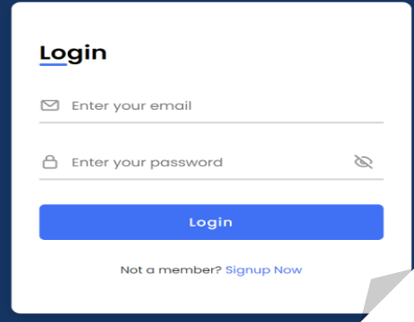
Login in Web Application

Slide 9
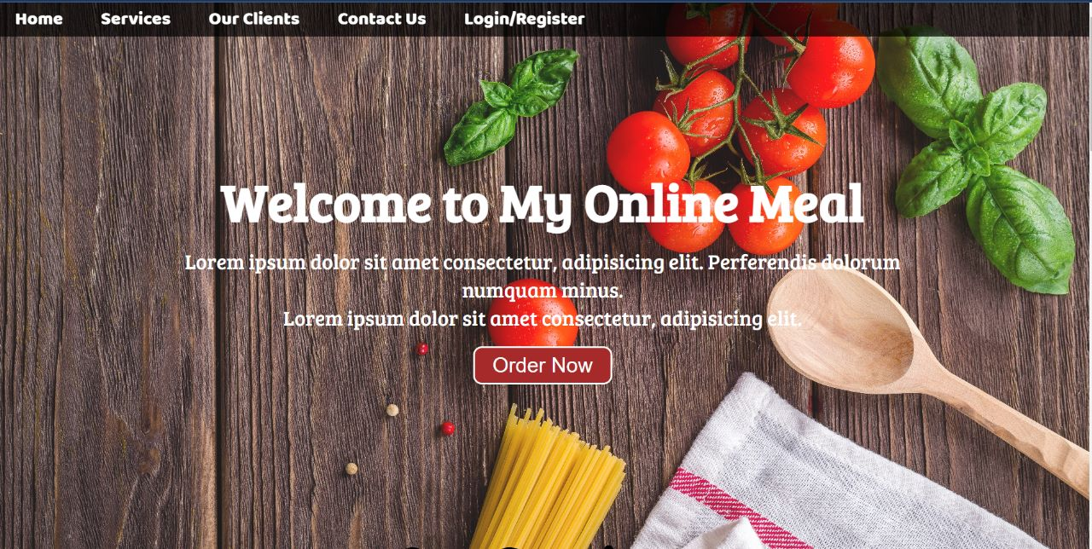
Welcome Page

Slide 10
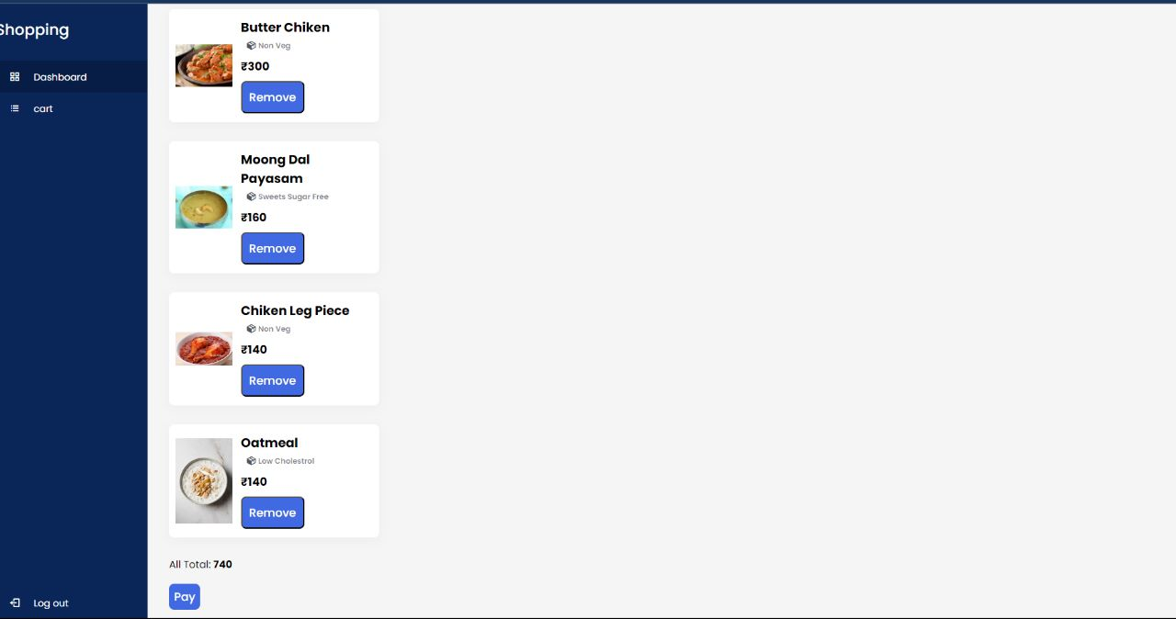
Cart

Slide 11
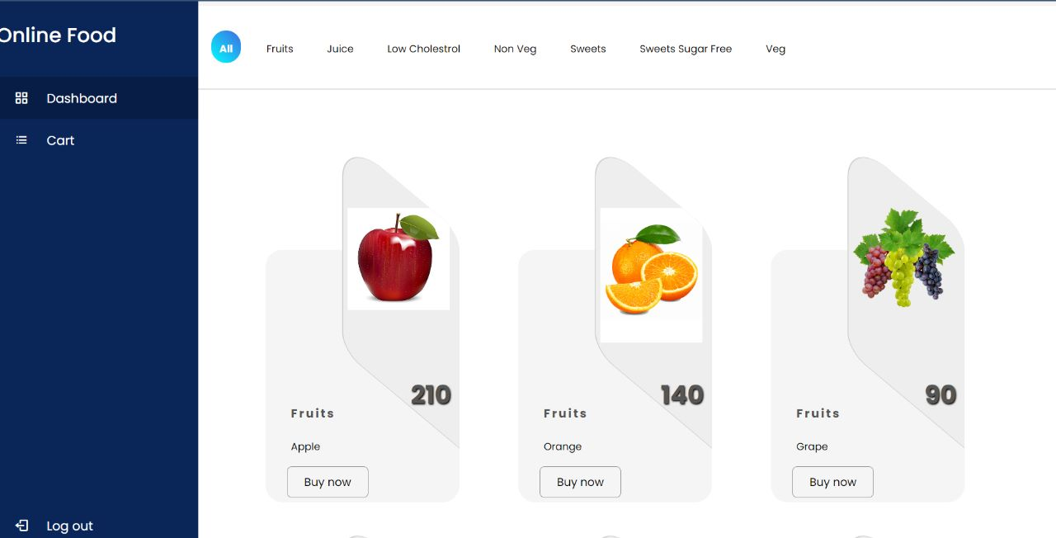
Customer Dashboard

Slide 12
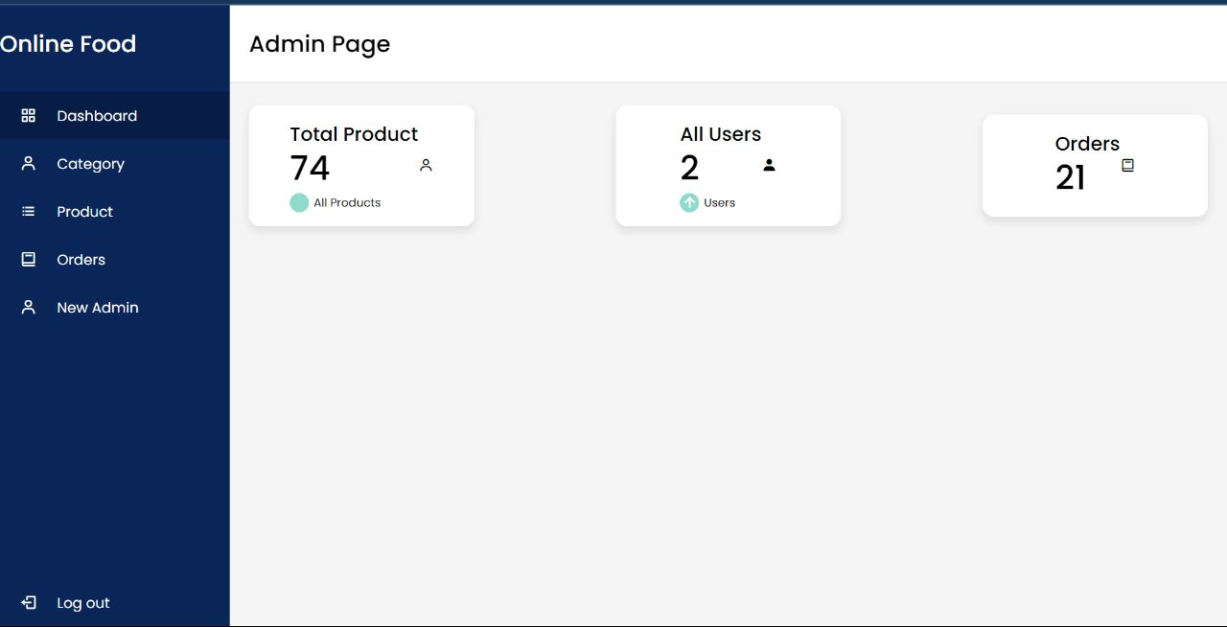
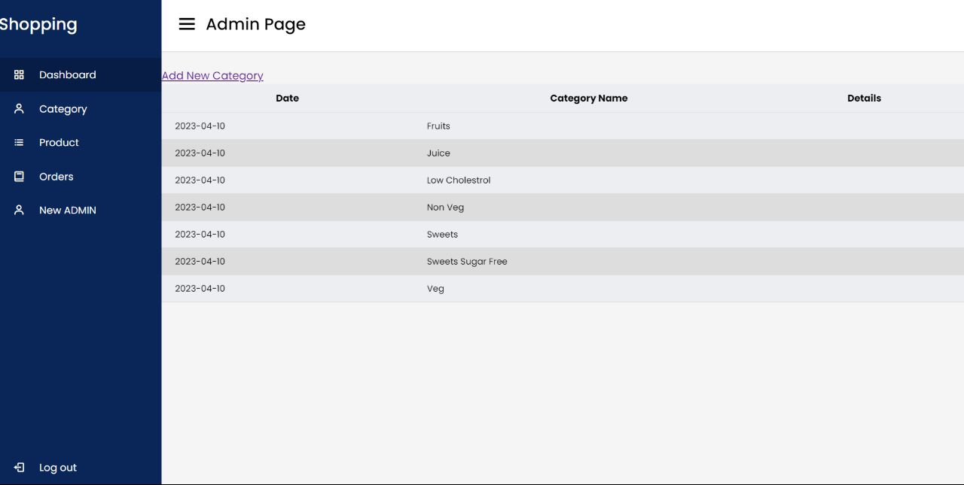
Admin Page

Slide 13
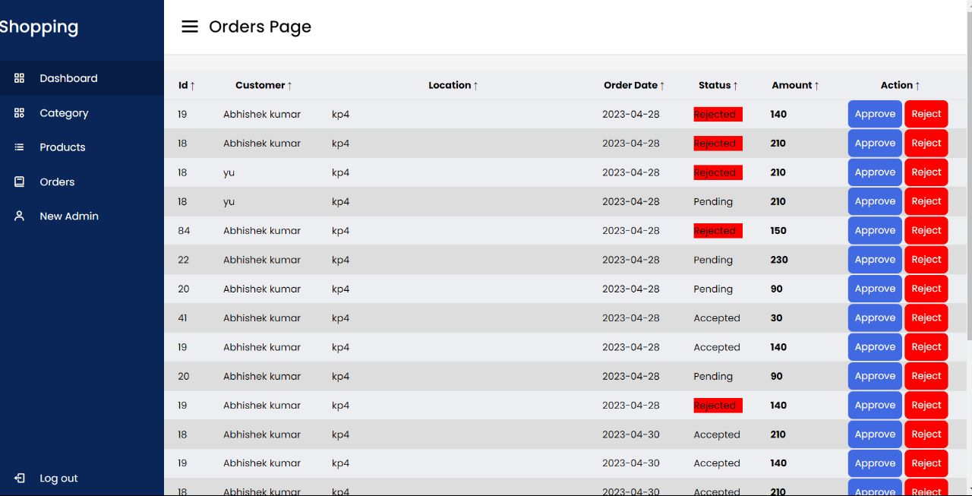
Ordering Receiving Page

Slide 14
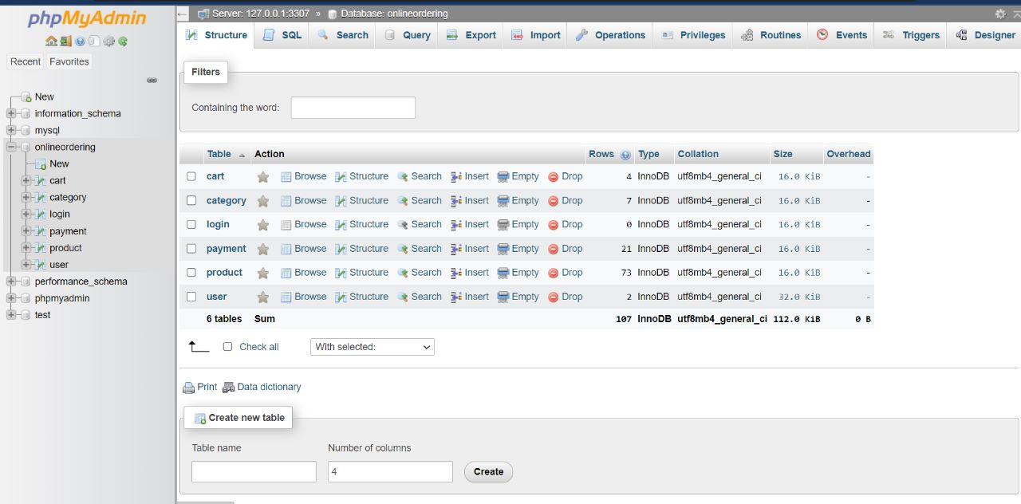
Database Page

Slide 15
Our Team
Abhishek Kumar
(2047001)
Siddharth Singh (2047006)

Slide 16
Our Team
Sankalp Acharya (2075023)
Arojeet Talukdar (2047009)

Slide 17
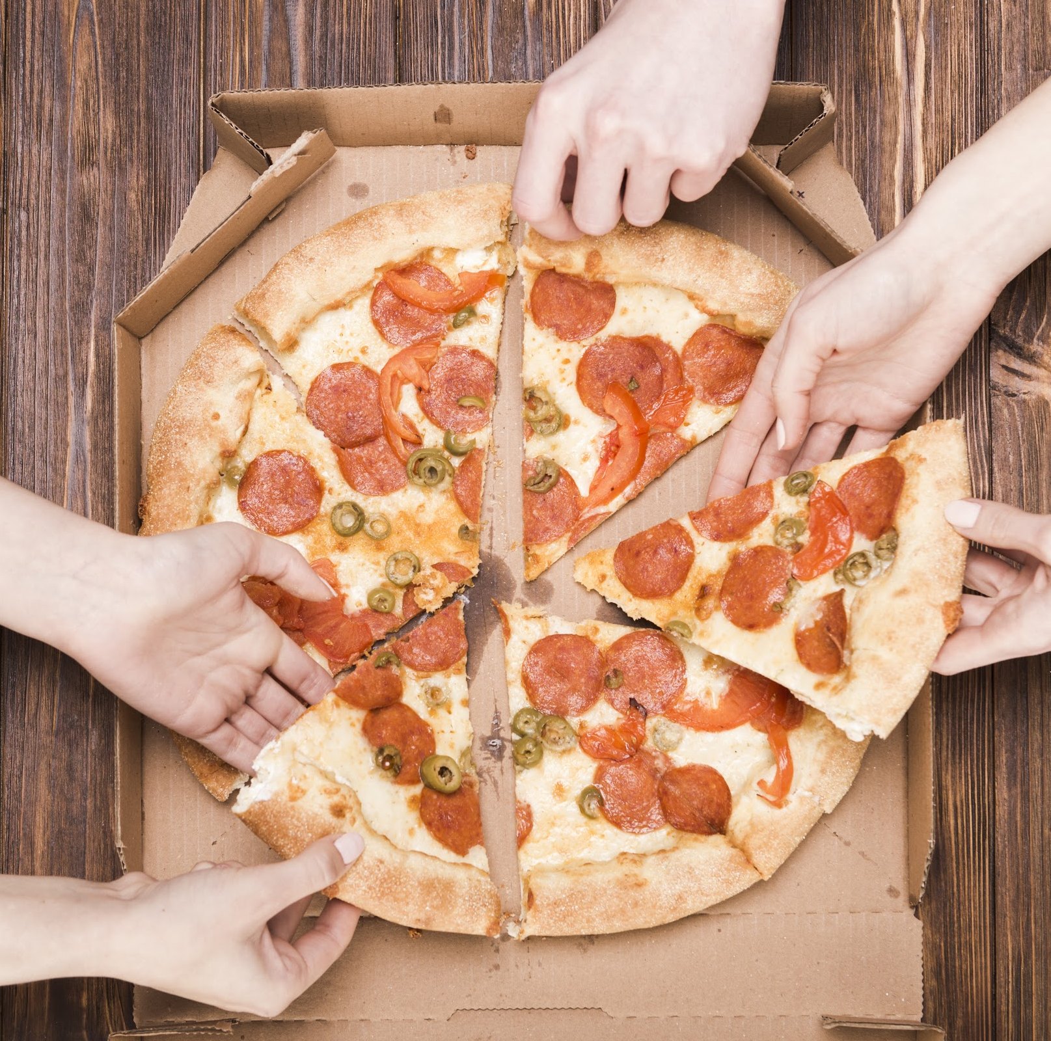
Summery
An Online Food Ordering System is a web-based platform that allows customers to order food from restaurants and other food providers through a website or mobile application. This system simplifies the process of ordering food by providing customers with a user-friendly interface to browse menus, select items, and pay for their order online. The system also allows restaurants to manage their menus, receive and process orders, and track their sales and inventory. Online Food Ordering Systems have become increasingly popular in recent years due to their convenience, speed, and accessibility, making them a preferred choice for customers and food businesses alike.

Slide 18
Thank You

